Slide 1

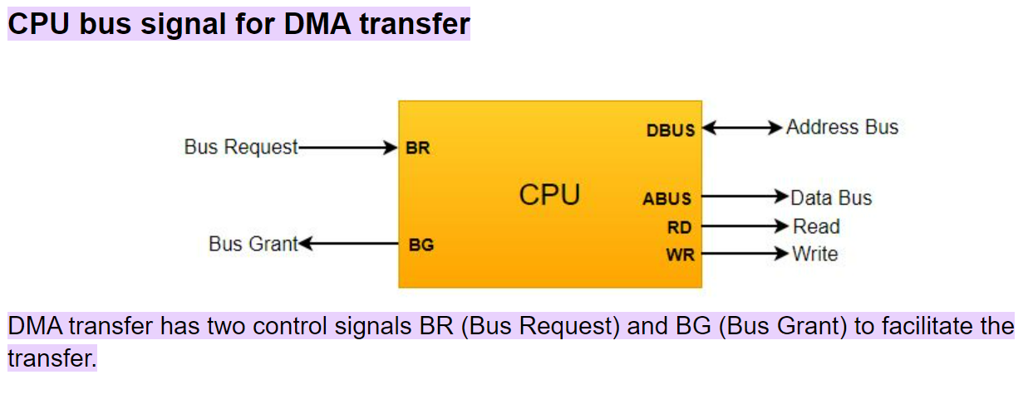
Direct Memory Access

Slide 2



Slide 3


Slide 4
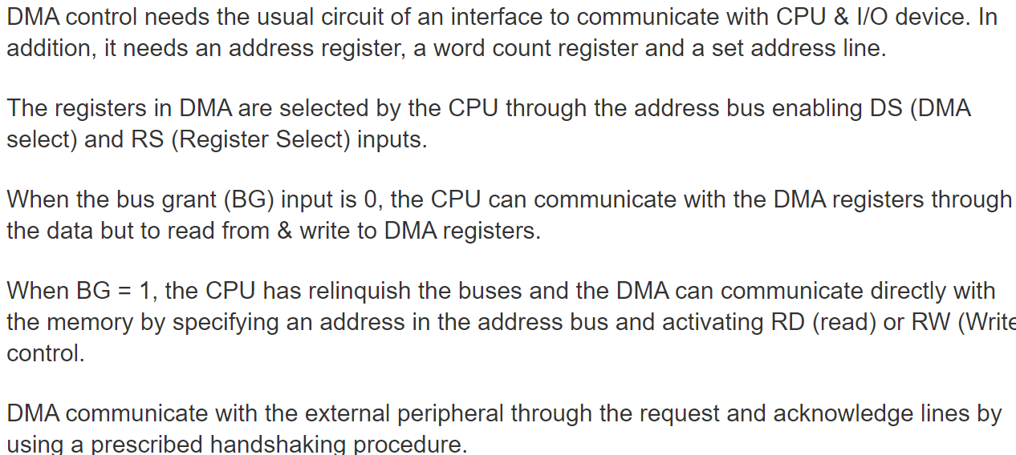
DMA Controller

Slide 5
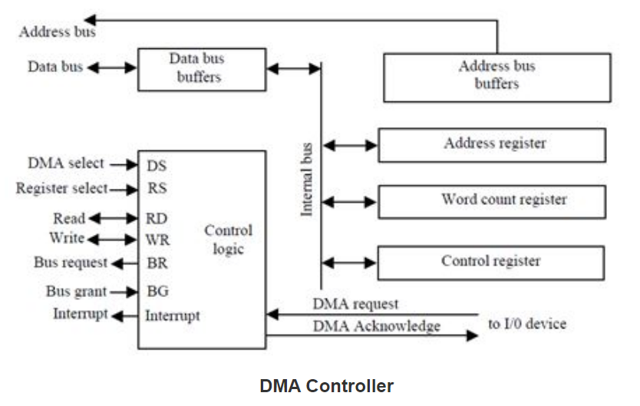
DMA Controller

Slide 6
